Slide 1



Week 3, Lecture 6
MySQL queries and joins

Slide 2
Admin stuff and reminders:
Don’t forget this week’s discussion topics!
https://login.codingdojo.com/d/309/121/1194
https://login.codingdojo.com/d/309/121/1195
Due Sunday night at 11:59 PM Pacific! Don’t fall behind!!
This week’s core assignments - there are four of them:
Dojos and Ninjas (in ERD Lessons)
Books
Dojos and Ninjas (in MySQL Queries)
MySQL Countries
Don’t fall behind on core assignments this week and next!
Remember the 20-minute rule!!
Feel free to collaborate with one another! You may use the lecture room!

Slide 3
How are you feeling today?
1 = Not good
10 = Very good

Slide 4
Week 3, Lecture 6 agenda:
The CRUD operations
INSERT (Create)
SELECT (Read)
UPDATE (Update)
DELETE (Destroy)
Joining tables
How joins work
(INNER) JOIN
LEFT JOIN
Identifying when to use each - important!
Grouping results (if time permits)

Slide 5
Question 1
What type of query would you run for each of these situations in a database of users? (Your answer should be one word - the first word in the query, so for example “INSERT.”)
Creating a new user
Grabbing the data for one user or any number of users
Saving changes to a user’s information
Removing a user permanently

Slide 6
Question 1
What type of query would you run for each of these situations in a database of users? (Your answer should be one word - the first word in the query, so for example “INSERT.”)
Creating a new user: INSERT
Grabbing the data for one user or any number of users: SELECT
Saving changes to a user’s information: UPDATE
Removing a user permanently: DELETE
These are called CRUD operations - for Create, Read, Update and Destroy/Delete.

Slide 7
Demo of MySQL queries

Slide 8
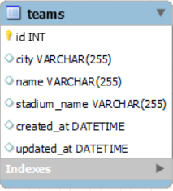
INSERT queries
When you want to add a new record or item to your database, you use an INSERT query.
Using this as an example:
The query to add a team would be:
INSERT INTO teams (city, name, stadium_name) VALUES ("Seattle", "Seahawks", "Lumen Field");
Notice that id, created_at and updated_at will be automatically generated if you set your tables up properly in advance (AI selected for id, NOW() default value for created_at and NOW() ON UPDATE NOW() default value for updated_at).

Slide 9
INSERT queries
The general syntax is:
INSERT INTO table_name (column_1_name, column_2_name) VALUES ("Value_1", "Value_2");
(For numbers and other functions you might use, you don’t need quotes.)
You can insert multiple records at once:
INSERT INTO teams (city, name, stadium_name) VALUES ("Chicago", "Bears", "Soldier Field"), ("Los Angeles", "Ram", "SoFi Stadium");
Use commas to separate each set of values you want to insert.
Remember to use commas to separate column names and values!
Make sure the number of items in each set of parentheses match up! So don’t have 3 columns you want to add values to and try to add only 2 values for 2 of the 3 columns.
ALL queries should end with a semicolon ;

Slide 10
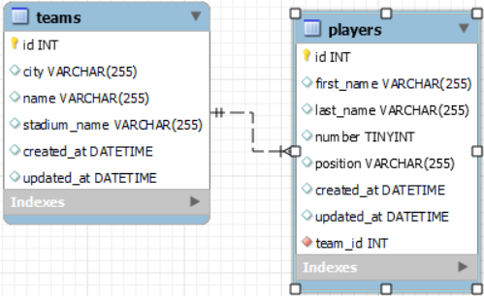
INSERT queries - with foreign keys
When you create records in a table with a foreign key, you MUST include a value for the foreign key. That value has to match an existing id in the other table.
For example, in the players table with a
foreign key named team_id:
INSERT INTO players (first_name, last_name, number, position, team_id) VALUES ("Russell", "Wilson", 3, "QB", 1); -- The 1 stands for the id of the team in the teams table

Slide 11
SELECT queries
If you want to grab information from your database, use a SELECT query.
To grab all teams, for example: SELECT * FROM teams;
The * means all columns. So you can narrow the results down if you want:
SELECT id, name FROM teams;
This will grab only the id and the name of each team.
To specific grab one team or a set of teams, use the WHERE clause:
SELECT * FROM teams WHERE id = 1;
You should more often than not use the primary key (usually id) for narrowing results with the WHERE keyword. (You can use other columns as well.) This is done to prevent ambiguity in filtering and searching.

Slide 12
SELECT queries
The general syntax is:
SELECT * FROM table_name; -- Grab all columns and rows from the table
SELECT column_1, column_2 FROM table_name; -- Grab two columns from the table
-- Grab all columns and rows from the table that match the condition(s) specified in the WHERE clause
SELECT * FROM table_name WHERE column_name = value;

Slide 13
UPDATE queries
Should you decide to make edits to your database, use an UPDATE query.
IMPORTANT: You should ALWAYS have a WHERE clause with an UPDATE query, otherwise you might accidentally update every record in your table!
To update a team, here is how:
UPDATE teams SET city = "Bellevue", name = "Ninjas" WHERE id = 2;
This means we’re changing the city and name for the record whose id is 2.
Here is the general syntax:
UPDATE table_name SET column_1 = "value_1", column_2 = "value_2" WHERE id = value;
You can have as many column-value pairs as you want; just separate them by commas (but don’t include a comma after the last pair, otherwise you’ll get a syntax error!).

Slide 14
DELETE queries
Suppose there is a row or record that you don’t need anymore. There is where a DELETE query is used.
IMPORTANT: Don’t forget to include a WHERE clause with a DELETE query, lest you delete your ENTIRE table!!
To delete a team, here is how:
DELETE FROM teams WHERE id = 2;
This means we’re deleting the team whose id is 2.
Here is the general syntax:
DELETE FROM table_name WHERE id = value; -- Can have additional conditions

Slide 15
Linking tables
Recall that MySQL is a relational database, where two or more tables can be linked together. So you can link a user with friends, an author with a bunch of books, a store with items that it sells, etc.
How can we connect the information together? By joining tables!

Slide 16
Question 2
Use this diagram to help - teams and players are a one-to-many (team to player) relationship.
Starting with the teams table, write a
query that grabs all the players in
each team. Make sure your query
grabs ALL teams, including those
with no players.

Slide 17
Question 2
Starting with the teams table, write a query that grabs all the players in
each team. Make sure your query grabs ALL teams, including those with no players.

Slide 18
Question 2
Starting with the teams table, write a query that grabs all the players in
each team. Make sure your query grabs ALL teams, including those with no players.
Correct: SELECT * FROM teams LEFT JOIN players ON teams.id = players.team_id;
Incorrect: SELECT * FROM teams JOIN players ON teams.id = players.team_id;
The correct query will grab all teams, including those with no players. The incorrect query ONLY grabs the teams with players enrolled, leaving out the teams with no players.

Slide 19

Diagram of different types of joins
Source link: https://www.codeproject.com/Articles/33052/Visual-Representation-of-SQL-Joins
In this course, you’ll primarily deal with (INNER) and LEFT JOINS

Slide 20
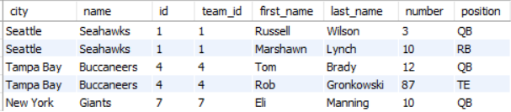
Syntax for joining tables
Here is how tables are joined together:
SELECT columns FROM left_table JOIN right_table ON left_table.key = right_table.key;
In this example (custom query to illustrate):
SELECT city, name, teams.id, players.team_id, first_name, last_name, number, position
FROM teams JOIN players ON teams.id = players.team_id;
Notice how those two columns match in value!
LEFT TABLE - teams
RIGHT TABLE - players

Slide 21
Syntax for joining tables
When joining tables, ALWAYS connect a primary key in one table to a foreign key in another table. In this example, we’re connecting the primary key of id in the teams table with the foreign key of team_id in the players table.
Notice how those two columns match in value!
Primary key
Foreign key

Slide 22
Syntax for joining tables
When joining tables, ALWAYS connect a primary key in one table to a foreign key in another table. In this example, we’re connecting the primary key of id in the teams table with the foreign key of team_id in the players table.
Notice how those two columns match in value!
LEFT TABLE - teams
RIGHT TABLE - players

Slide 23
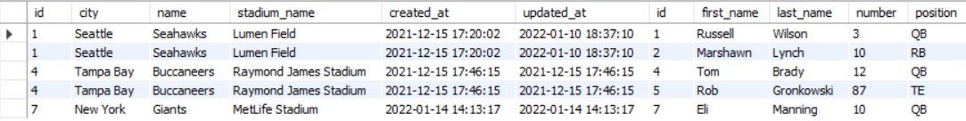
(Inner) joins
An (inner) join is used to connect two tables together. ONLY the records that have a connection will appear. Imagine this example with tables of cars and manufacturers (one-to-many with manufacturers to cars): if you start with manufacturers and join cars, any manufacturers with NO cars linked to them will not show up in the results.
Here is the syntax for an (inner) join:
SELECT columns FROM left_table JOIN right_table ON left_table.key = right_table.key;
Here is an example with teams and players:
SELECT * FROM teams JOIN players ON teams.id = players.team_id;
LEFT TABLE - teams
RIGHT TABLE - players

Slide 24
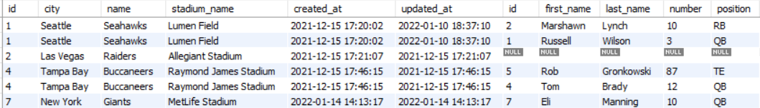
Left joins
A left join is another way to connect tables, with the expectation that ALL records from the left table will be returned, REGARDLESS of if there is any connection to the right table. Here is an example with players and teams:
Here is the syntax for a left join:
SELECT columns FROM left_table LEFT JOIN right_table
ON left_table.key = right_table.key;
Example:
SELECT * FROM teams LEFT JOIN players ON teams.id = players.team_id;
Notice how the Raiders have no players linked to the team, as those columns have NULL.
LEFT TABLE - teams
RIGHT TABLE - players

Slide 25
Narrowing results with joins
There’s nothing stopping you from adding a “WHERE” clause to your query!
For example, to grab all the players linked to a specific team:
SELECT * FROM teams LEFT JOIN players
ON teams.id = players.team_id
WHERE teams.id = 1; -- Grab the team whose id is 1 AND players (if any) who joined
Notice we need the table name “teams” in the WHERE clause as the “id” column exists in both tables!

Slide 26
Narrowing results with joins
Some of you might try this query:
SELECT * FROM players JOIN teams
ON players.team_id = teams.id
WHERE teams.id = 1;
While this would work, there is a catch - would this query work if you wanted to show the team’s info when no players have joined?
The answer is NO! The query would return nothing at all if a team has no players - so you wouldn’t even get the information on the team at all.
This illustrates the importance of picking the correct table to start with! (See next slide.)

Slide 27
(Inner) join vs. left join
Knowing which type of join you should use is very important. It comes down to asking yourself what information you must display.
The starting table is a good starting point. Pick the table whose information you want to grab regardless of if there’s any connections to any other tables.
For example, if you want to show all the information about a specific user, regardless of any items connected to them, you should start with your users table. Same logic with showing a team - start with the teams table.

Slide 28
(Inner) join vs. left join
Now ask yourself - is this a one-to-many or many-to-many (or one-to-one) relationship?
If the relationship is…
One-to-many:
LEFT JOIN if starting with the one side of the relationship (e.g. the teams table in a teams-players one-to-many relationship)
JOIN if starting with the many side of the relationship (e.g. the players table in the teams-players one-to-many relationship)
Many-to-many: use LEFT JOINs always
(One-to-one: JOIN if the table has a foreign key, LEFT JOIN if it doesn’t)

Slide 29
Demo of joining tables

Slide 30
Grouping results (if there’s time)

Slide 31
Bonus/group exercises

Slide 32
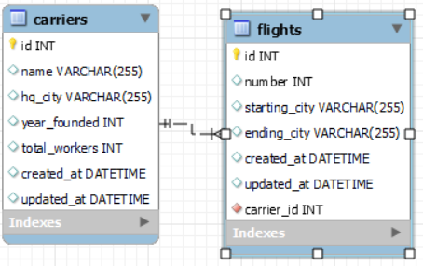
More MySQL ERD practice, plus queries
Create and forward-engineer this diagram. (The name of the model can be anything you wish - but note that that will be what it will be called when you look at your schemas in local host.)

Slide 33
More MySQL ERD practice, plus queries
Practice the following in this order:
Create 5 carriers.
Create 5 flights. (Make sure you link the carriers! You can pick any carrier to link to, but try to have at least one carrier not be linked to any flights for this exercise.)
Now change the name of any single carrier.
Grab all the carriers WITH their flights - including those that don’t have any flights linked to them. (HINT: what type of join should we use?)
Grab one flight WITH its carrier information linked.
Grab all the flights for one carrier - make sure you grab all the information about the carrier itself, even if there are no flights.
Delete any flight.
Delete any carrier.

Slide 34
More MySQL ERD practice, plus queries
Answers will vary based on the IDs and values you use, but the general structure of the queries should be essentially the same.
INSERT INTO carriers (name, hq_city, year_founded, total_workers) VALUES ("Alaska", "Seattle", 1935, 20000);
INSERT INTO flights (number, starting_city, ending_city, carrier_id) VALUES (750, "Seattle", "San Francisco", 1);
UPDATE carriers SET name="Alaska Airlines" WHERE id = 1;
SELECT * FROM carriers LEFT JOIN flights ON carriers.id = flights.carrier_id;
SELECT * FROM flights JOIN carriers ON carriers.id = flights.carrier_id WHERE flights.id = 1;
SELECT * FROM carriers LEFT JOIN flights ON carriers.id = flights.carrier_id WHERE carriers.id = 1;
DELETE FROM flights WHERE id = 1;
DELETE FROM carriers WHERE id = 1;

Slide 35
Python algo challenge
Write a function that accepts a string as input and determines whether it is a palindrome or not (returns True or False). A palindrome is a word or phrase that reads the same forwards and backwards, such as “eye”, “madam”, “sees”, etc. To simplify the problem, you may assume that the string will only consist of letters, numbers and spaces. BONUS: make it case-insensitive - i.e. “Eye” should return True.
Examples:
“hello” should return False
“pep” should return True
“abba” should return True

Slide 36
Python algo challenge
Here is one solution (answers will vary):
def is_palindrome(test_string):
new_string = test_string.lower() # Convert to lower case
str_len = len(new_string) # Length of string
for x in range(int(len(new_string)/2)): # Notice the divide by 2
# print(f"Character at index {x}: {new_string[x]}") # Character in first half
# print(f"Character at index {str_len-1-x}: {new_string[str_len-1-x]}") # Character in second half of string
if new_string[x] != new_string[str_len-1-x]: # If letters at current points in first half and second half don't match
return False # Stop the loop and return False
return True # It is a palindrome if we check the entire string out

